Slide 1


Strategic Insights:
Analyzing Social Buzz's Data Landscape

Slide 2


Today's agenda
Project recap
Problem
The Analytics team
Process
Insights
Summary

Slide 3

Navigating Social Buzz's data landscape, our team handled scaling issues, performed a thorough audit, and derived crucial insights. Our analysis identifies content trends, sentiment dynamics, and interaction patterns, providing strategic direction for improved user experiences and content strategy.
Project Recap

Slide 4


Problem
Social Buzz faced challenges in efficiently scaling and managing vast amounts of unstructured data generated by its diverse user base, prompting the need for strategic insights and solutions to ensure sustained growth and a seamless IPO transition.

Slide 5



MAE MULLIGAN,
MANAGING DIRECTOR
The Analytics team
MICHELLE GROVE,
DATA SCIENTIST
ABDULLAH JAFRI,
DATA ANALYST

Slide 6
Process
1
Understanding Business Problem
2
Data Preparation:
3
Data Analysis:
4
Extracting Insights:
5
Presentation

Slide 7
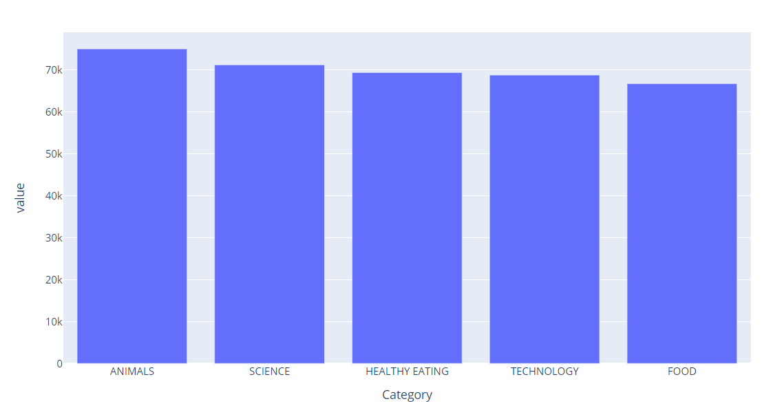

Insights
Top Content Categories:
Animals, Science, Healthy Eating, Technology and Food are the top five content categories with the highest aggregate popularity on Social Buzz.

Slide 8
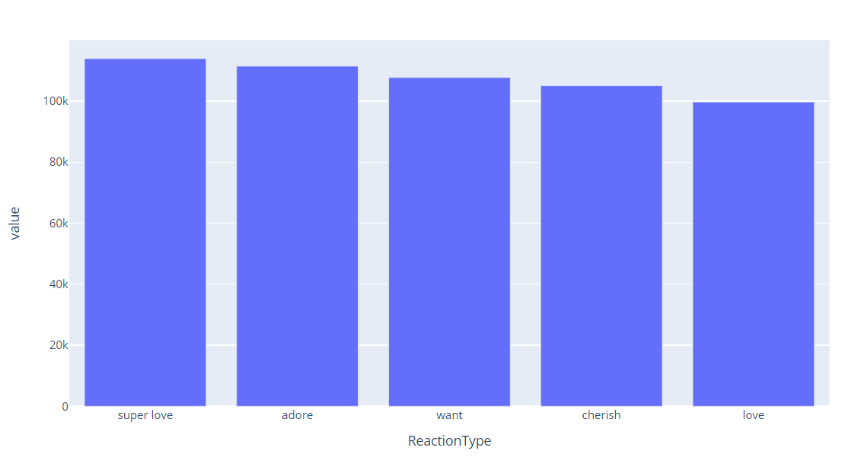
Sentiment Patterns:
The sentiment analysis of content reveals a predominant focus on ‘super love' and ‘adore' indicating areas where user sentiments are more positive.

Slide 9
Content Engagement Breakdown:
Photos lead in user engagement on Social-
Buzz with a total score of 62,838, showcasing the platform’s diverse content landscape encompassing videos, GIFs, and audio.

Slide 10

In navigating Social Buzz's data landscape, our team addressed scaling challenges and conducted a comprehensive audit. Insights uncovered top content categories, emphasizing Animals, Science, and Healthy Eating, while sentiment analysis highlighted a predominant focus on ‘super love' and ‘adore.' Examining content types revealed diverse engagement, with photos leading in user interaction. These insights position Social Buzz strategically to optimize content strategies, enhance user engagement, and prepare for future growth, ultimately contributing to a holistic and informed data-driven approach.
Summary

Slide 11

Thank you!
ANY QUESTIONS?

